Slide 1






Title : Concrete Strength model
Date : 29 - 02 - 2024
Presented by: Jessica Sebastian : 0808ds211054
Aanchal Soni : 0808ds211002
Kratika Ghadge : 0808ds211061
Abhishek Yadav : 0808ds211007
Abhishek Nainawat:0808ds211006
Course: AI Builder
Course Code:FITT03
Mentor Name: Soorya Suresh

Slide 2
Overview
Introduction
Project Plan
Objectives
Methodology
Review of the Models used
Experimental Results
Conclusion
References

Slide 3
Introduction
Concrete's Vital Role: Concrete is foundational in civil engineering, crucial for global construction projects, with compressive strength as a key indicator of its ability to withstand loads.
Advanced Predictive Models: Recent advancements in computational modeling and data analytics have led to more precise estimations of concrete strength by analyzing extensive datasets on compositions and testing results.
Practical Implications: Accurate strength prediction models are not only theoretically significant but also practically vital for optimizing mix designs, enhancing construction efficiency, and minimizing material wastage, ensuring optimal performance and durability of concrete structures.
Project Objective: This project aims to develop a robust strength prediction model integrating empirical data and advanced computational techniques to estimate concrete compressive strength under varied conditions.
Ultimate Goal: Through rigorous validation and refinement, the project seeks to provide engineers and industry professionals with a valuable tool for optimizing concrete formulations and enhancing the quality and durability of civil infrastructure.

Slide 4

Contribution of Team Members
Planning & Research
Conducted in-depth research on existing systems.
Prepared project reports and established timelines.
Development
Led backend development with Python , Flask and py charm.
Collaborated on frontend design using HTML/CSS/JS.
Testing & Presentation
Conducted rigorous testing.
Prepared and delivered the project presentation.
Collaboration:
All members actively contributed to discussions and decision-making.
Regular communication ensured project success.
Kratika & Abhishek Nainawat
Abhishek Yadav
Aanchal & Jessica

Slide 5
Project Plan

Slide 6
Technologies Used :
Python:
Python is widely used due to its simplicity, versatility, and extensive library support. Its easy-to-learn syntax, cross-platform compatibility, and active community make it ideal for diverse applications such as web development, data analysis, machine learning, automation, and scientific computing.
Flask :
Flask provides a convenient and versatile framework for integrating machine learning models into web applications, deploying them into production environments, and building scalable and interactive machine learning-powered applications.
Pycharm :
PyCharm is widely used in machine learning projects due to its robust features, ease of use, and seamless integration with Python scientific computing libraries and tools. It provides developers with the tools and capabilities they need to efficiently develop, debug, and manage machine learning applications and algorithms.
Html :
HTML is used in machine learning projects to create user interfaces, visualize data, collect input, integrate with web services, and generate reports, helping to enhance the usability, accessibility, and effectiveness of machine learning applications in various domains.

Slide 7
Project Schedule
Table 1. Project Schedule
S.No. | Phase | Tasks | Total Time
1. | Planning | Define project objectives and scope. | 2 days
2. | Research & Setup | Research about concrete | 1 day
 |  | Set up development environment | 1day
3. | Development | To predict concrete strength | 4 days
 |  | Integrate all code | 2 days
 |  | Develop user interface | 3 days
4. | Testing | Test predict model | 2days
 |  | Bug fixing and refinement | 1day
 | Total Project Duration |  | 2 weeks

Slide 8
Objectives
Developing a Robust Concrete Strength Prediction Model:
Integrating empirical data and advanced computational techniques. Utilising extensive datasets on concrete compositions and testing results.
Accurate Estimation of Compressive Strength:
Under diverse environmental conditions. Considering variations in material compositions.
Validation and Refinement Process:
Rigorous validation procedures to ensure reliability. Continuous refinement to improve predictive accuracy.
Providing a Valuable Tool for Engineers
Enhancing the quality and durability of civil infrastructure.

Slide 9
Methodology

Slide 10
Data Collection
Dataset Name: Concrete Data
Components (kg in a m^3 mixture)
Cement
Blast Furnace Slag
Fly Ash
Water
Superplasticizer
Coarse Aggregate
Fine Aggregate
Additional Parameter: Age (in days)
Target Variable: Concrete Compressive Strength (MPa,megapascals)

Slide 11
Model Training
Linear Regression (lr):
The Linear Regression model achieved a mean squared error (MSE) of [value] and an R^2 score of [value].
This indicates [evaluation of performance - e.g., good fit, poor fit, underfitting, overfitting].
Lasso (lss):
The Lasso Regression model achieved a mean squared error (MSE) of [value] and an R^2 score of [value].
This indicates [evaluation of performance - e.g., good fit, poor fit, underfitting, overfitting].
Ridge (Ridg):
The Ridge Regression model achieved a mean squared error (MSE) of [value] and an R^2 score of [value].
This indicates [evaluation of performance - e.g., good fit, poor fit, underfitting, overfitting].

Slide 12
Model Training (Contd.)
Decision Tree Regressor (dtr):
The Decision Tree Regressor model achieved a mean squared error (MSE) of [value] and an R^2 score of [value].
This indicates [evaluation of performance - e.g., good fit, poor fit, underfitting, overfitting].
XGBoost Regressor (xgb):
The XGBoost Regressor model achieved a mean squared error (MSE) of [value] and an R^2 score of [value].
This indicates [evaluation of performance - e.g., good fit, poor fit, underfitting, overfitting].
Replace [value] with the actual numerical values obtained from your model evaluation. Additionally, provide an evaluation of the model's performance based on the MSE and R^2 Score, such as whether the model is a good fit for the data, if it exhibits signs of underfitting or overfitting, etc.

Slide 13
Model Working :
Step 1: Start the Flask Application
Run the following command to start the Flask application:
Copy code : python app.py
This will start the Flask development server.
Step 2: Access the Application
Open a web browser.
Enter the following URL in the address bar: http://127.0.0.1:5000/
Press Enter to load the application.

Slide 14
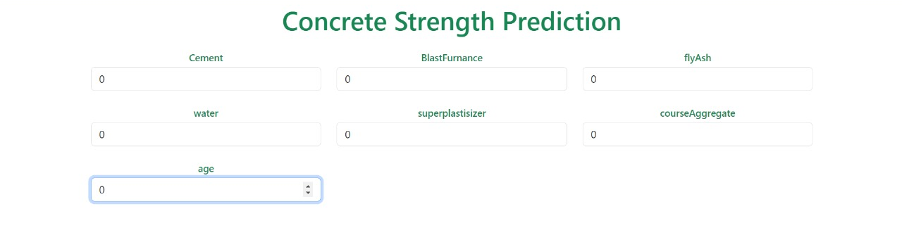
Step 3: Use the Application
Once the application is loaded in the web browser, you can interact with it by entering input parameters related to concrete compositions and environmental conditions.
Submit the form to see the predicted compressive strength of the concrete.
Step 4: Shutdown the Application
To stop the Flask development server, go back to the terminal where it's running.
Press Ctrl + C to stop the server.

Slide 15
Experimental Results

Slide 16

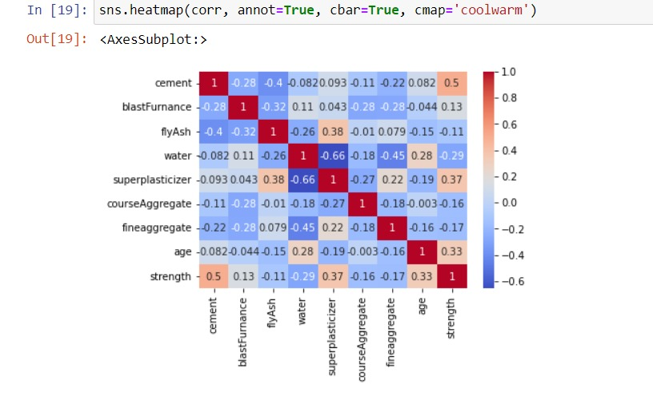
Heat map :
Feb 2024
29

Slide 17
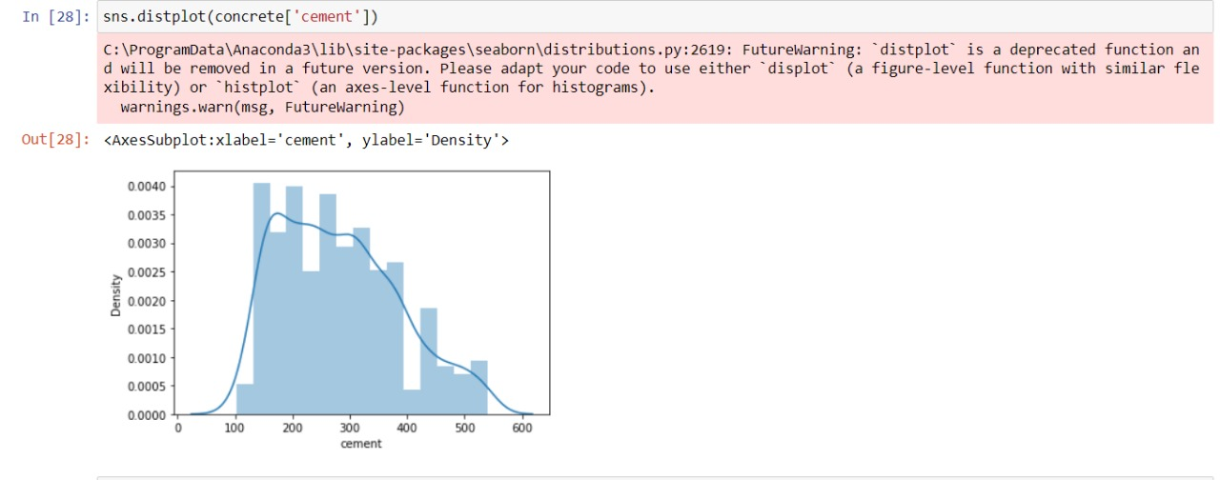
Distribution Plot

Slide 18
Conclusion
In summary, the concrete strength model project is a useful tool for predicting how strong concrete will be based on its ingredients. By analyzing the elements in the mix, it helps improve concrete formulations, ensuring structures are sturdy and construction processes are more efficient. This project represents a meaningful advancement in our ability to predict and enhance concrete strength.

Slide 19
References
https://ieeexplore.ieee.org/document/8701370
https://archive.ics.uci.edu/ml/datasets/Concrete+Compressive+Strength
https://ieeexplore.ieee.org/document/8620905
Parent Directory
Concrete_data.xlsx
Concrete_Readme.txt

